Slide 1

Sentiment Analysis of economic conditions based on global news reports
Instructor: Professor Jingyi Sun
GROUP 6
Akshit Walia Mayank Raj

Slide 2
Introduction
The global economic outlook is very important for making financial decisions going forward for individuals, organizations, and countries. Since economics is a complex domain it is not feasible for people who are not familiar with economic concepts to accurately measure the sentiments of the markets based on the news headlines. This often leads to hasty decisions based on emotions.
The goal of this project is to build a sentiment analysis system for specific sectors and regions based on news reports which are generated on internet.

Slide 3
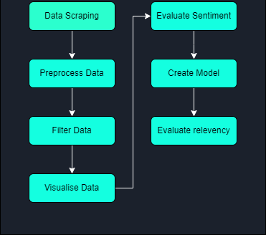
Project Workflow

Slide 4
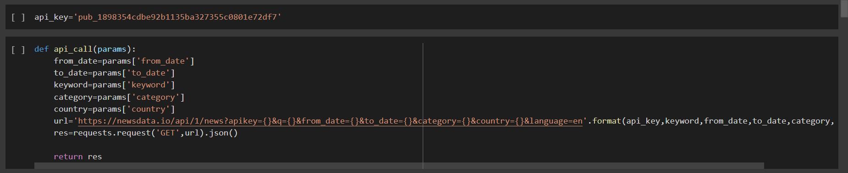
Data Scraping
We use an API called newsdata.io to fetch data from online news sites with relevant data and categories . We use the function api_call() to fetch data using the parameters defined using function create_params(). The API is unfortunately restricted to 10 articles currently

Slide 5
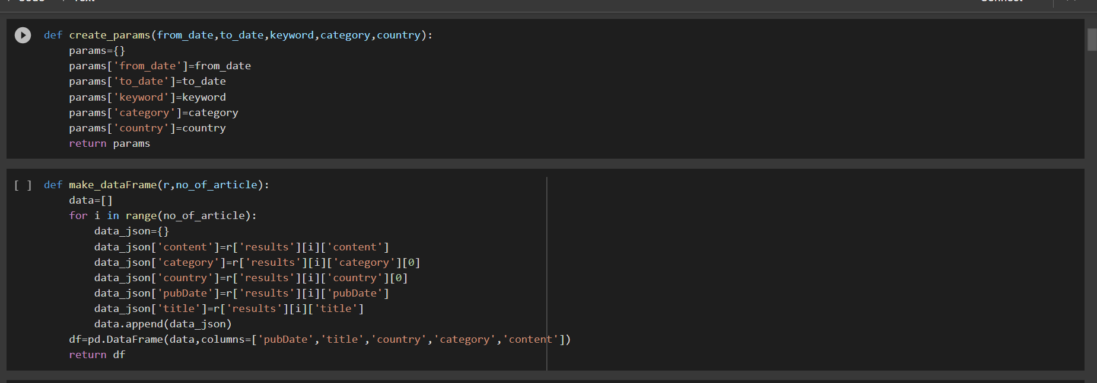
Data Scraping (continued)

Slide 6
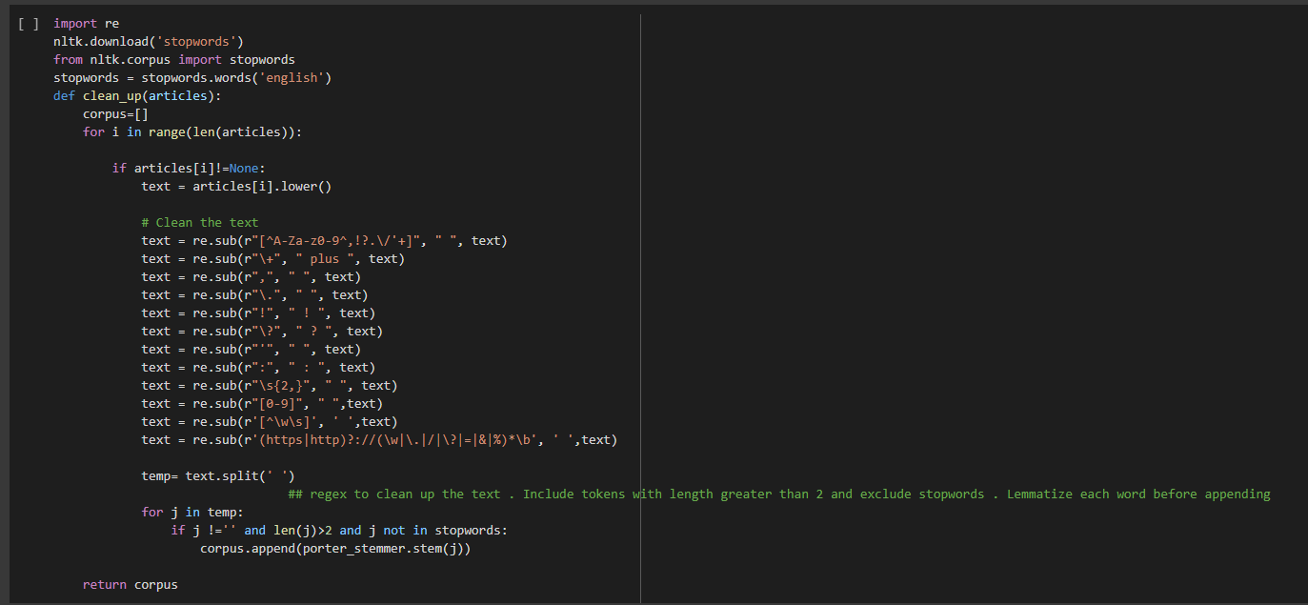
Data Pre-processing & Filtering
We need to clean the articles of any stopwords and special characters. We do that using the clean_up function. The function mainly uses regex and then breaks up sentences into words and stores them as a list.

Slide 7
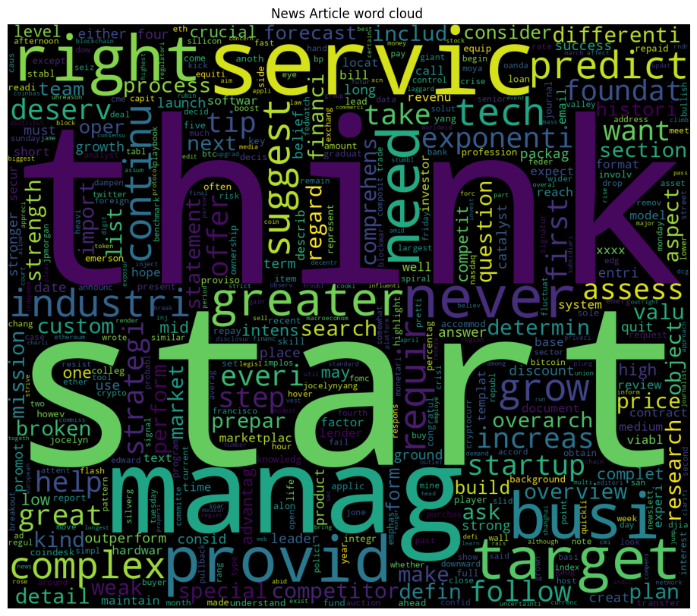
Data Visualisation
Next, we plot a frequency distribution graph and word-cloud using the data to better understand the data

Slide 8
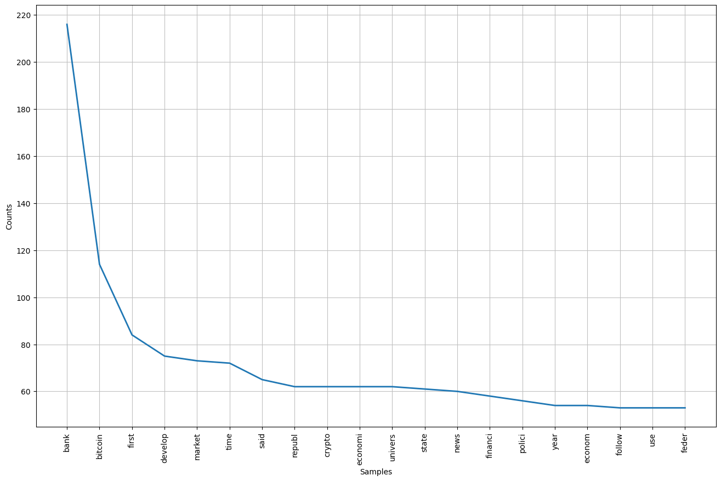

Slide 9
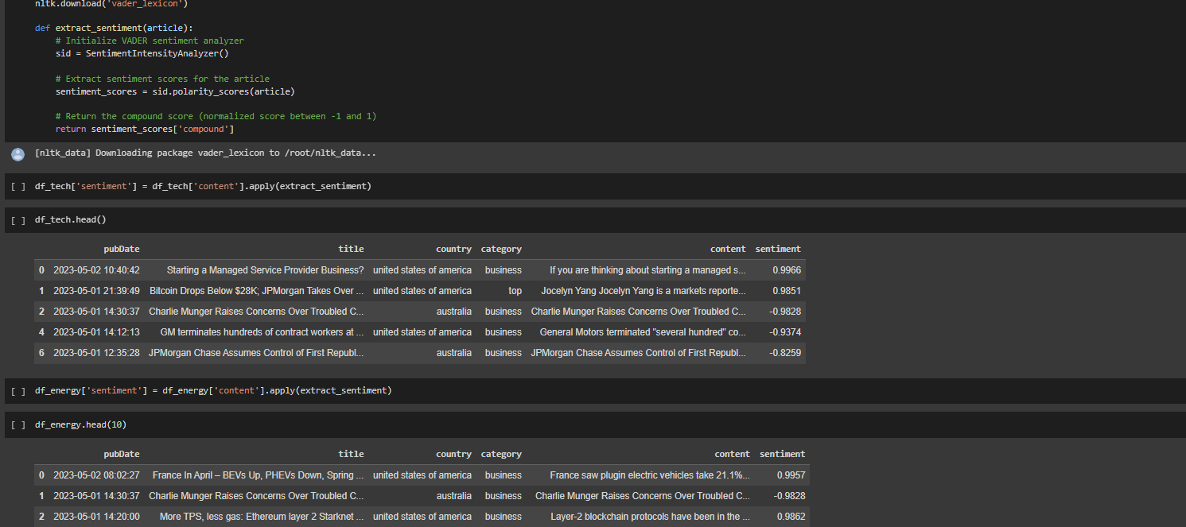
Sentiment Evaluation
Next we initialize VaderSentiment and use it to analyze the sentiment for the data. VADER (Valence Aware Dictionary and sEntiment Reasoner) is a lexicon and rule-based sentiment analysis tool that is specifically attuned to sentiments expressed in social media. We calculate sentiments for each category of articles then merge them together

Slide 10
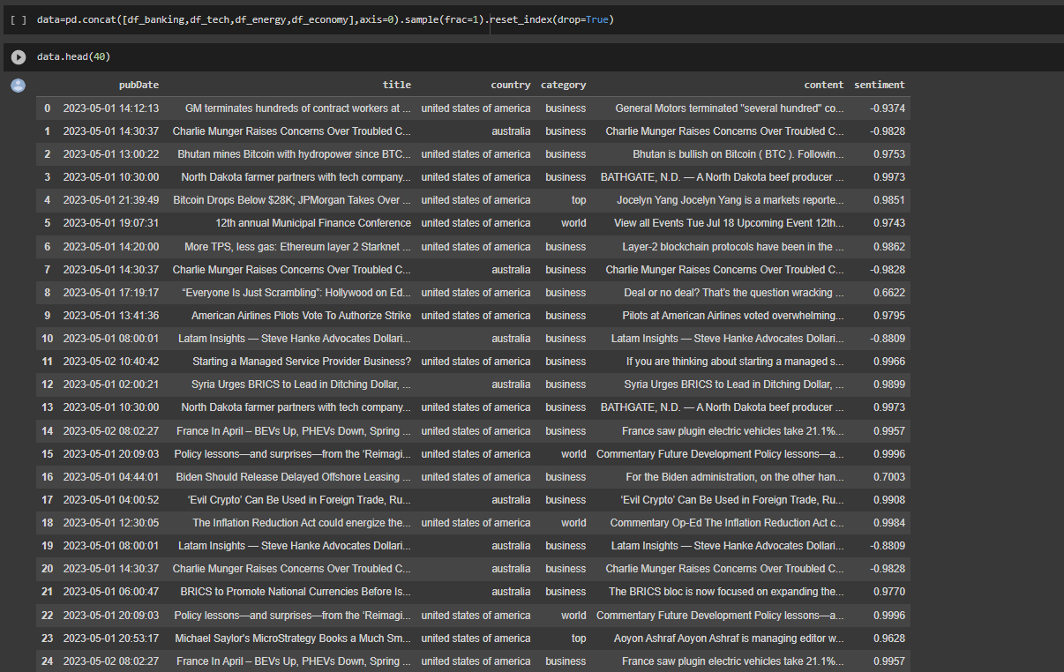

Slide 11
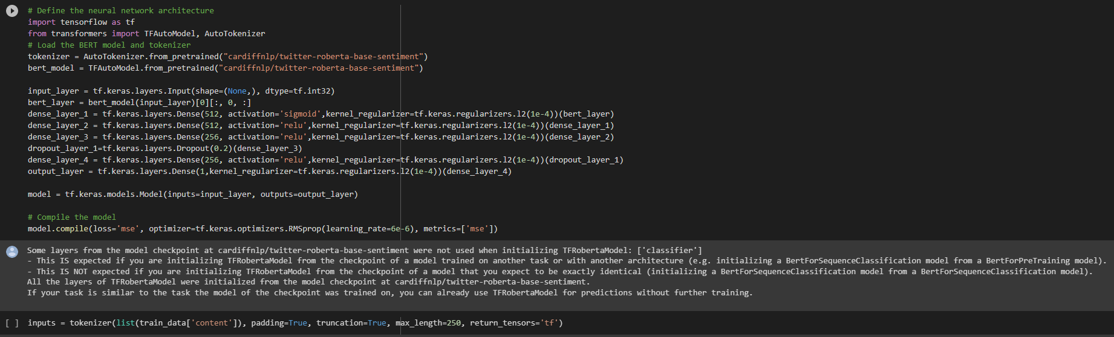
Model Creation & Training
To create the model, we first split the data into train and test data. We then define the neural network architecture and load the Twitter Roberta Based Sentiment model and tokenizer. This is a roBERTa-base model trained on about 58M tweets and fine tuned for sentiment analysis with the TweetEval benchmark.

Slide 12
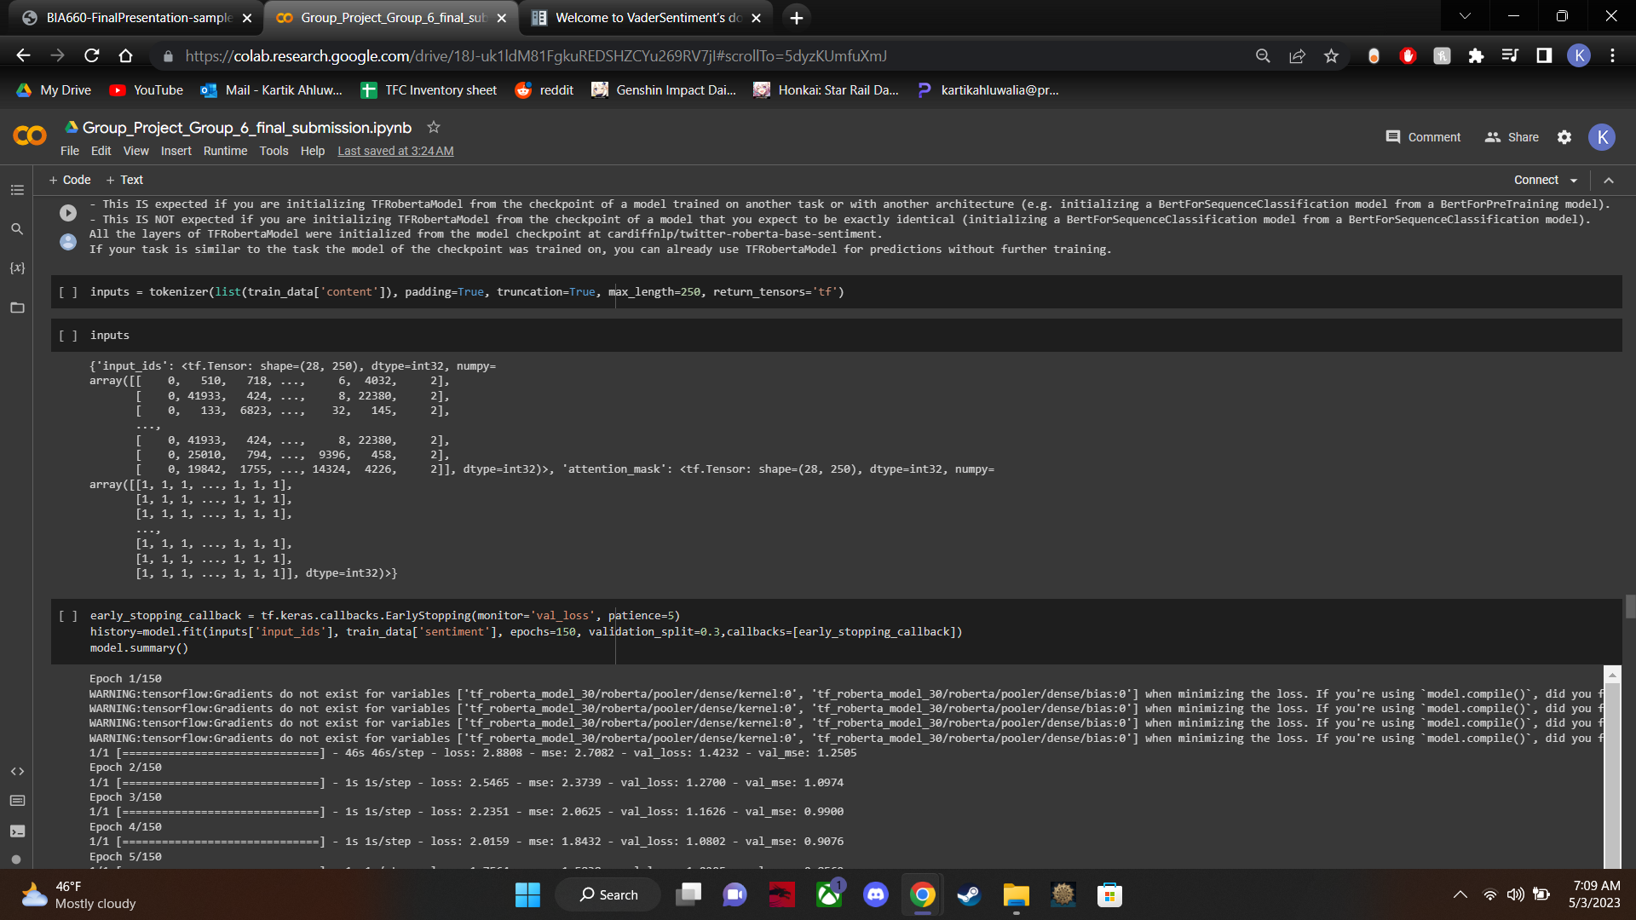
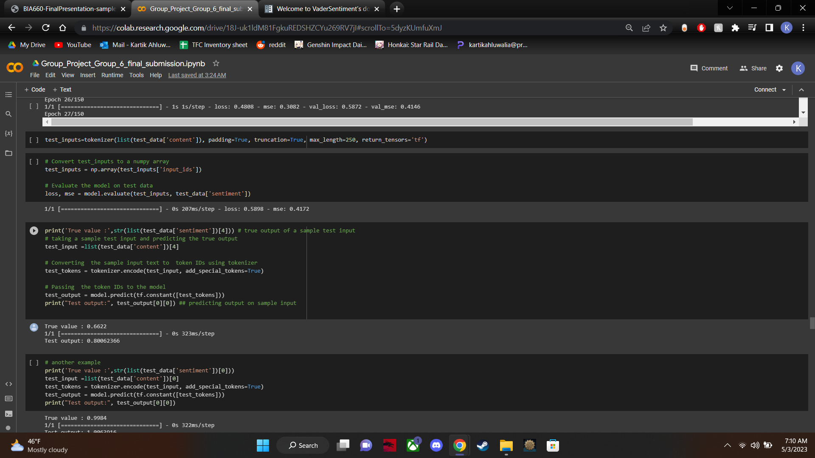

Slide 13
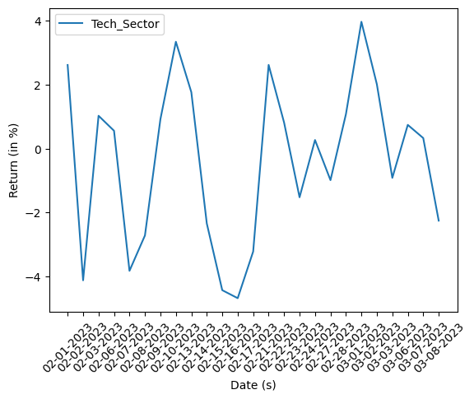
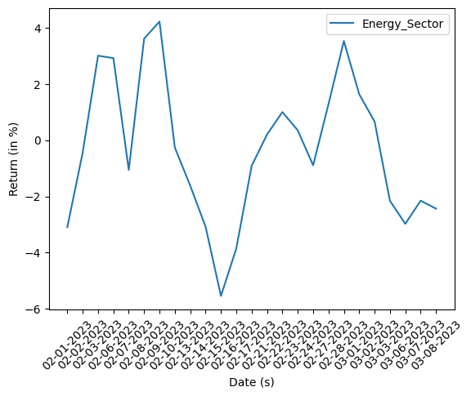
Model Evaluation
We plot the returns over time of different structures as a means of visualisation

Slide 14
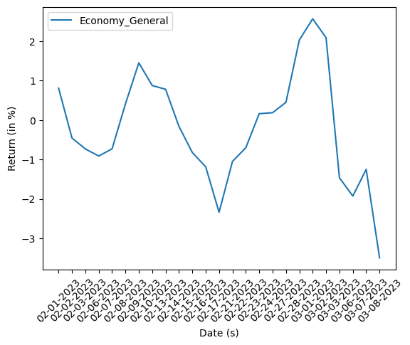

Slide 15
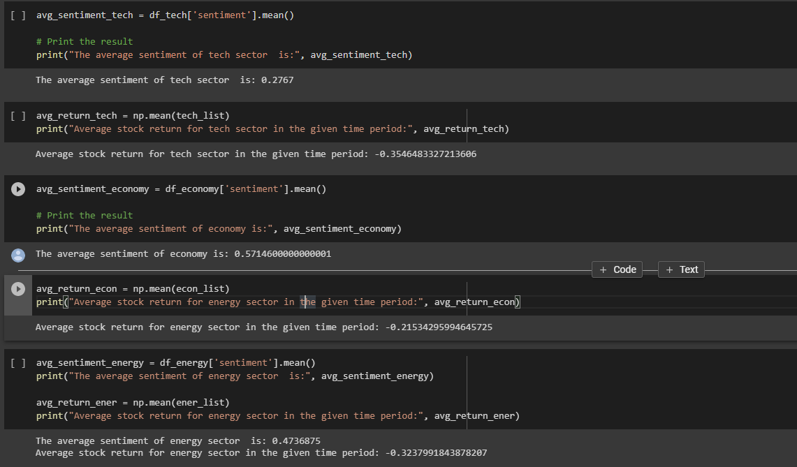
Model Evaluation (Continued)
We calculate the average sentiments as well as stock returns of each sector as a means to calculate a correlation score and find out the robustness of our hypothesis

Slide 16
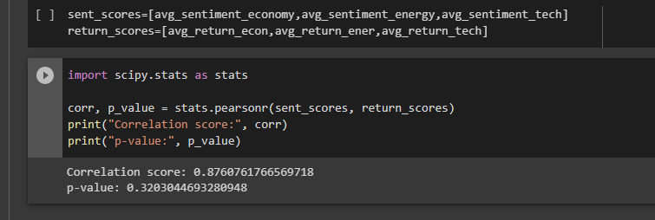
Results
As seen in the screenshot above, we obtain values Correlation score = 0.8760761766569718 p-value = 0.3203044693280948

Slide 17
Conclusion & Future Work
We see that even with such a small number of articles, the model is able to obtain a correlation score of roughly 0.876 This implies that our hypothesis holds promise and that sentiment analysis on news media can be reliably used towards predicting market returns if researched and expanded upon.
The model can be further expanded upon using weighted sentiment analysis on basis of title recency, article performance as well as author relevancy. It is also given that using a more robust data-scrapper will only serve to better the model significantly

Slide 18

Thank you!
Please feel free to ask any questions!

